Slide 1
P2 – Group 1
Gabriel Klein, Grant Muse, Jesse Sabbath

Slide 2
Goals
Create a Spark application to process Covid data
Discover trends in the data and how we can use these trends to make useful decisions

Slide 3
Tech Stack
Scala 2.11.12
Hadoop 3.2
Spark 3.1.2
sbt 1.5.5
IntelliJ
Excel
GitHub

Slide 4





GitHub
https://github.com/GabrielMichaelKlein/p2-Group-1

Slide 5
Trends We Explored
Covid cases/deaths over time by state in US
Covid cases/deaths by population per state in US
Death to Case ratios by country

Slide 6

Covid Cases/Deaths Over Time (US)

Slide 7
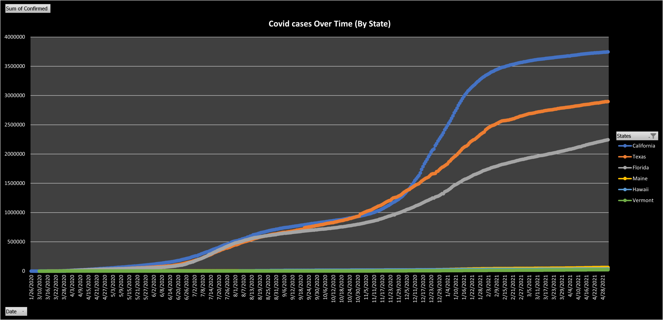

Slide 8
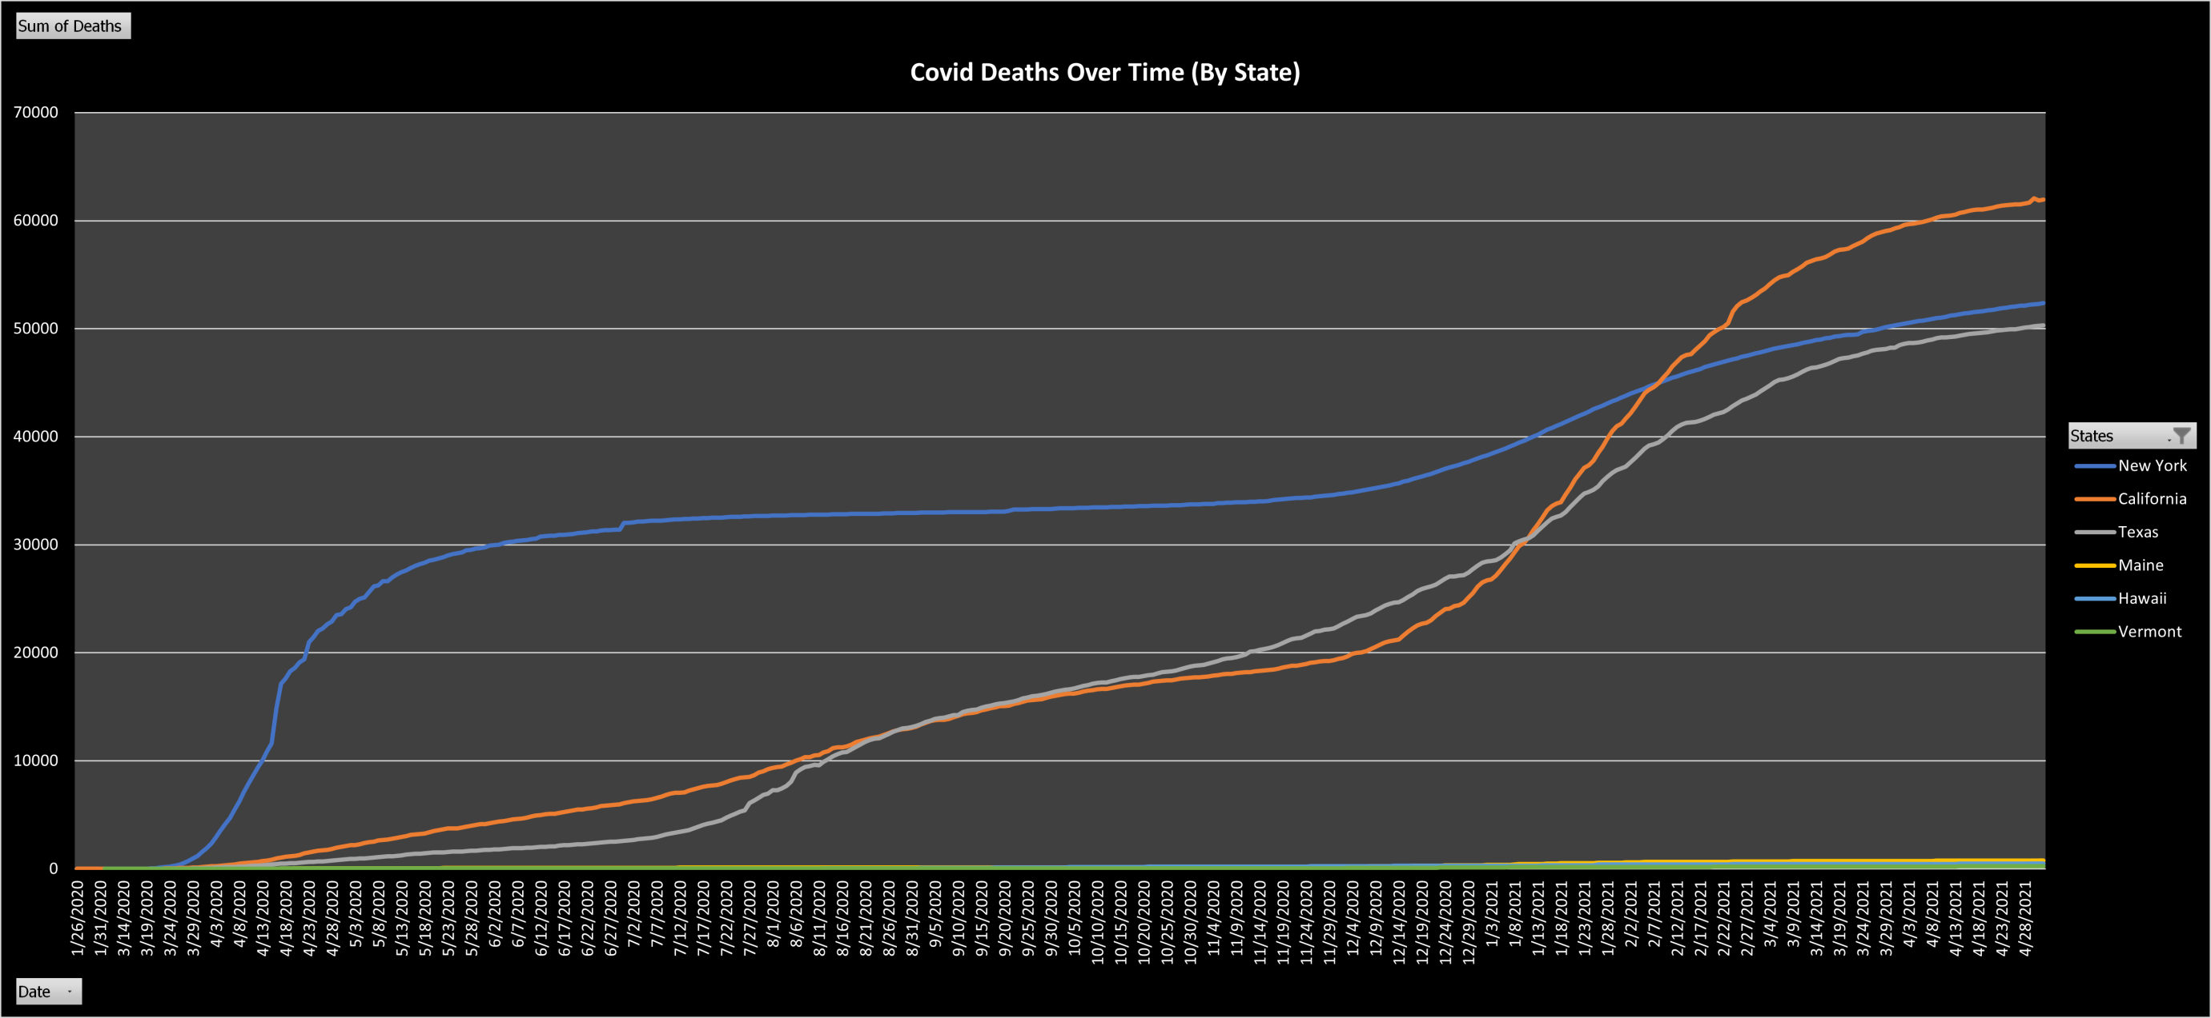

Slide 9
Covid Cases/Deaths By Country

Slide 10
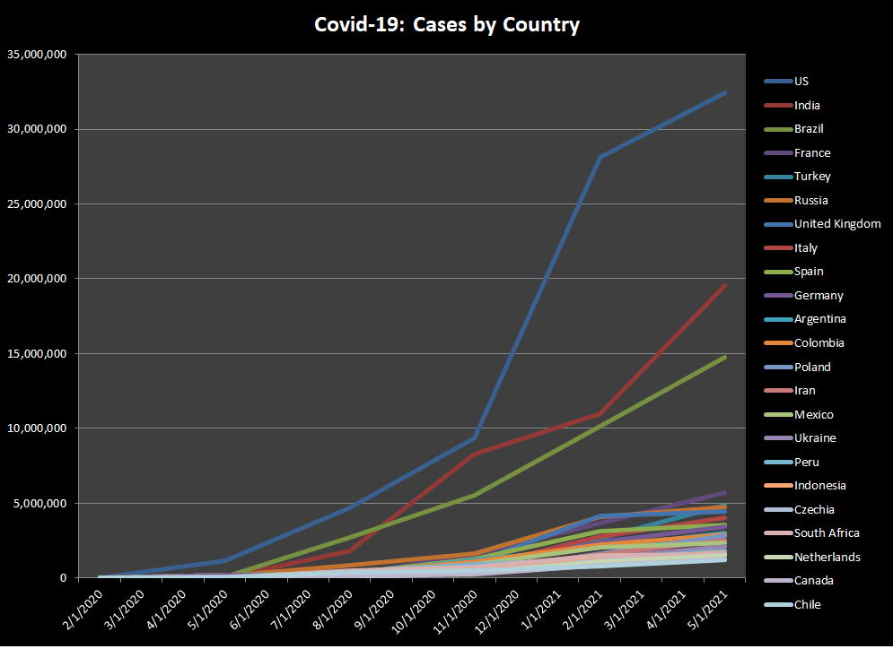

Slide 11
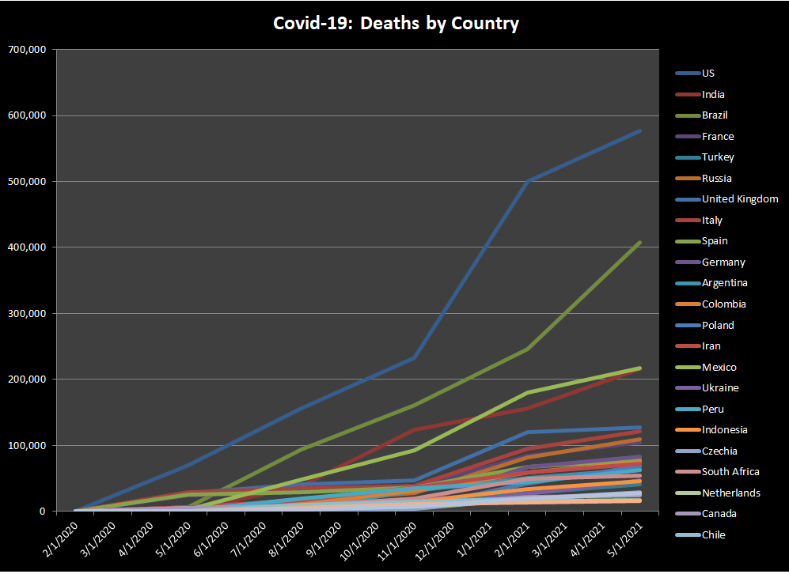

Slide 12
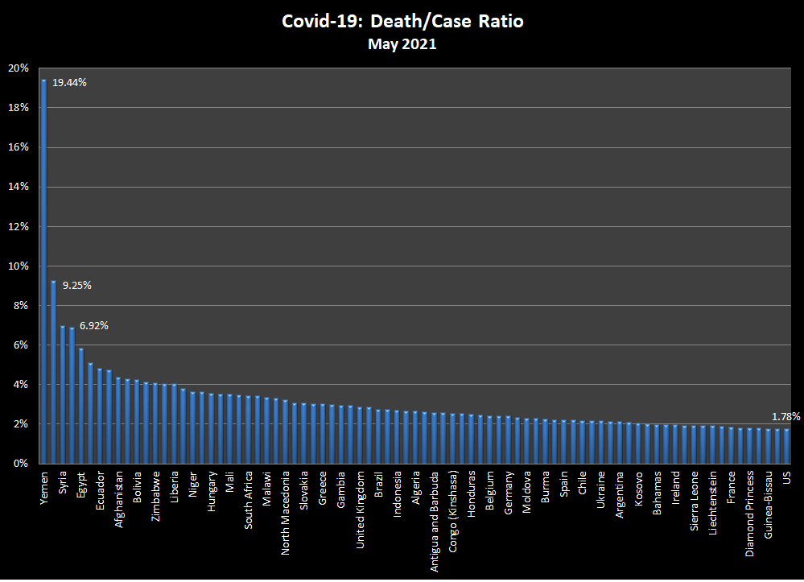

Slide 13
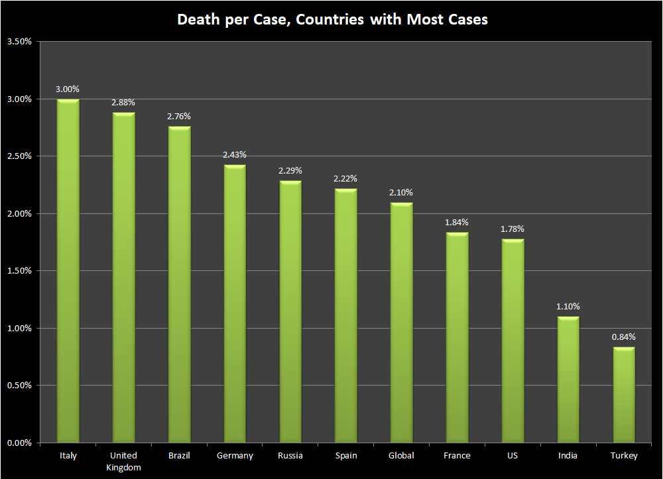

Slide 14
Covid Cases/Deaths by Population

Slide 15
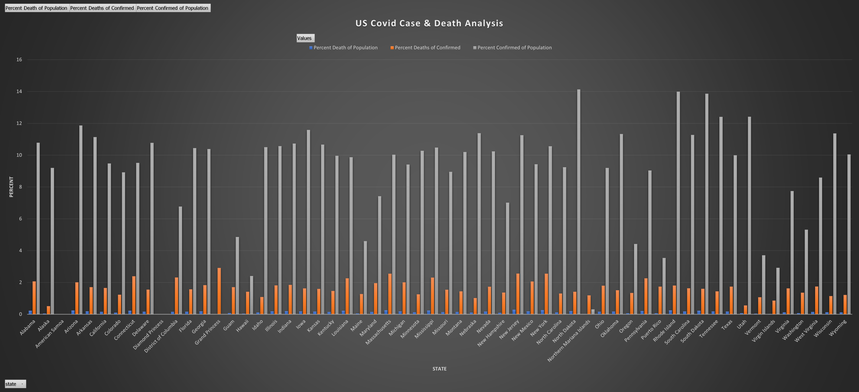

Slide 16
US Findings
High exposure events leads to an increase in infections and deaths
Holiday Season 2020
Suggested action
Limit high exposure events and travel

Slide 17
Global Findings
Underreporting skews the numbers
Lack of access to medical treatment may boost death rates
United States (1.78%) death per case ratio lower than global ratio (2.01%)
Global ratio is driven up slightly by outliers
Suggested action:
Countries with 3.5% > ratio > 2%
Hard push for vaccination
Continued masking and social distancing
Countries with ratio > 3.5%
Hard push for vaccination
Lockdown, if possible

